Slide 1
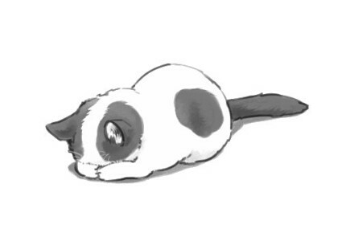
Copyrights ⓒ 2018 Taehoon

Slide 2
https://www.advancedwebranking.com/html/
Copyrights ⓒ 2018 Taehoon

Slide 3
CSS
Copyrights ⓒ 2018 Taehoon

Slide 4
Cascading Style Sheets
Copyrights ⓒ 2018 Taehoon
Notes:
캐스케이딩 스타일 시트
마크업 언어가 실제 표시되는 방법을 기술하는 언어
마크업 언어가 몸체를 담당한다면 CSS는 옷과 액세서리와 같은 꾸미는 역할 담당
HTML 구조는 그대로 두고 CSS 파일만 변경해도 전혀 다른 웹사이트처럼 꾸밀 수 있다

Slide 5
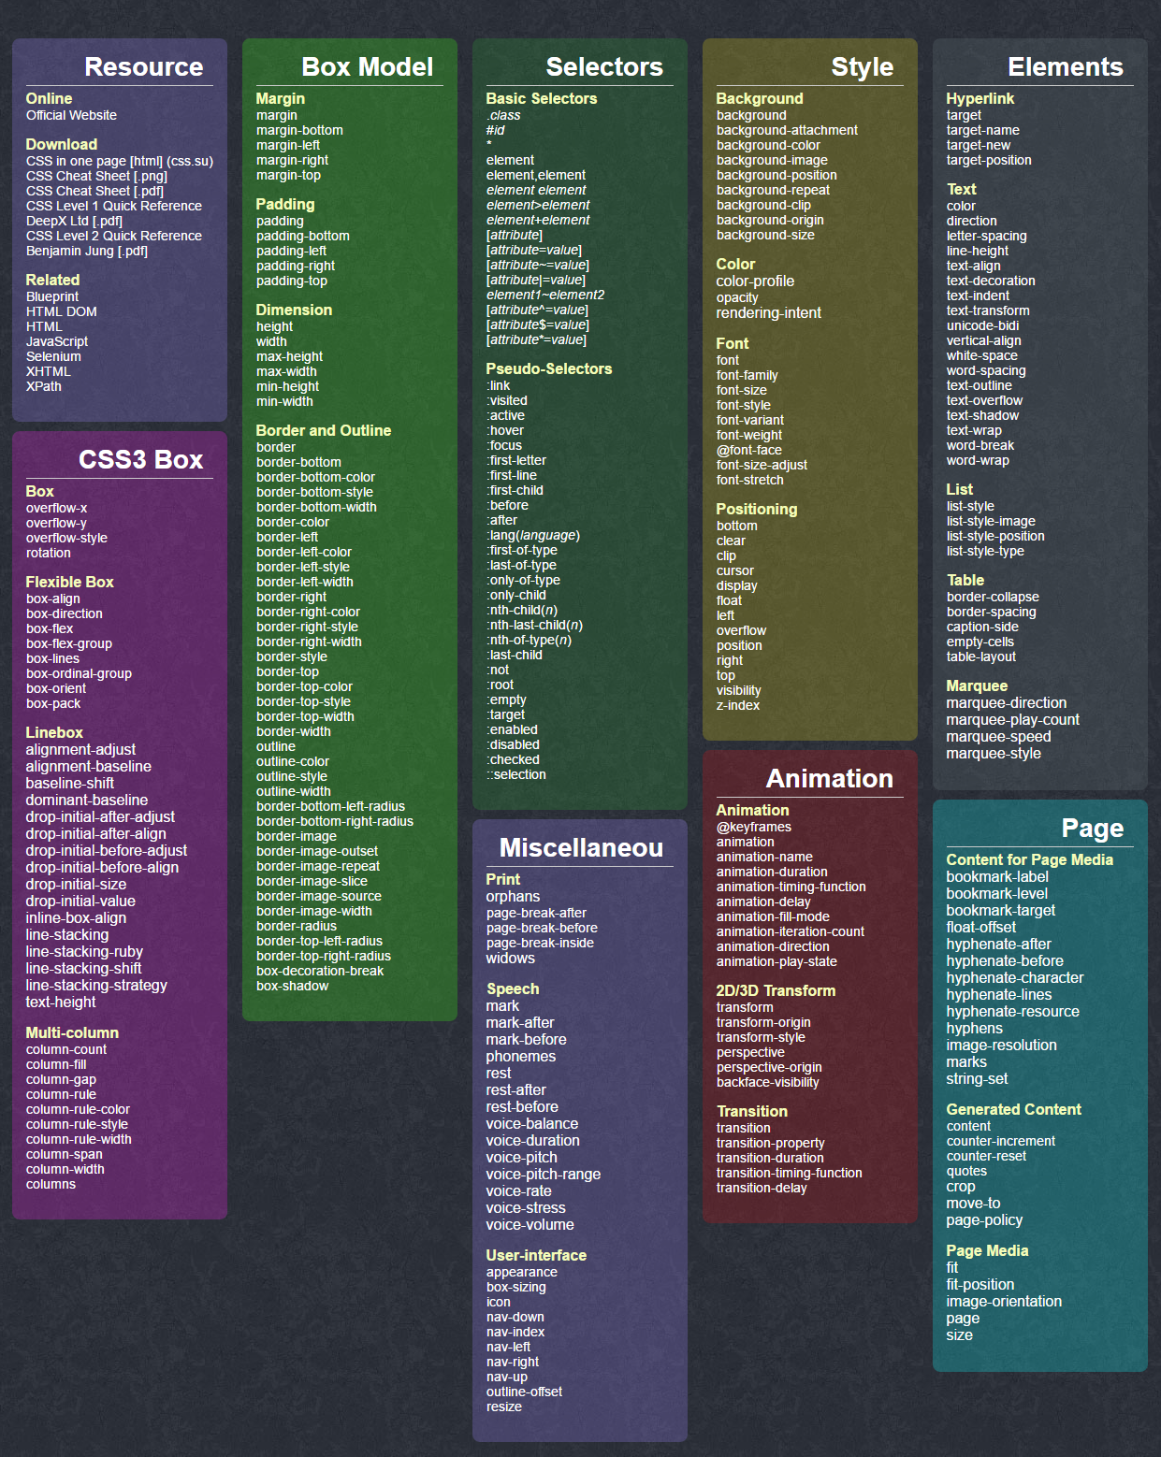
Copyrights ⓒ 2018 Taehoon
Notes:
수많은 css properties

Slide 6
Selector
#id
.class
Copyrights ⓒ 2018 Taehoon
Notes:
selector
id와 class

Slide 7
ID's are unique
Each element can have only one ID
Each page can have only one element with that ID
Classes are NOT unique
You can use the same class on multiple elements.
You can use multiple classes on the same element.
Copyrights ⓒ 2018 Taehoon
Notes:
출처: https://css-tricks.com/the-difference-between-id-and-class/

Slide 8
Font
WebFont
Background
Align
Copyrights ⓒ 2018 Taehoon

Slide 9
Font
Copyrights ⓒ 2018 Taehoon

Slide 10
font-family
font-size
font-style
font-weight
color
text-decoration
letter-spacing
text-shadow
Copyrights ⓒ 2018 Taehoon

Slide 11
WebFont
Copyrights ⓒ 2018 Taehoon

Slide 12
https://fonts.google.com/
Copyrights ⓒ 2018 Taehoon

Slide 13
Background
Copyrights ⓒ 2018 Taehoon

Slide 14
background-image
background-color
background-position
background-repeat
background-size
Copyrights ⓒ 2018 Taehoon

Slide 15
Align
Copyrights ⓒ 2018 Taehoon

Slide 16
text-align
margin
padding
border
Copyrights ⓒ 2018 Taehoon

Slide 17

Copyrights ⓒ 2018 Taehoon

